Slide 1
The Generalized Random Tessellation Stratified Method for Selecting Spatially-Balanced Samples

Slide 2
Historical Context
In response to the concern over acid precipitation in the 1980’s, The National Acid Precipitation Assessment Program (NAPAP) conducted several nation-wide surveys of the acidification status of surface waters
These were the first national-level, probability-based surveys of the condition of an environmental resource

Slide 3
Historical Context
A number people who had worked on the NAPAP assessment were convinced that the US needed a national-level assessment of the condition of all environmental resources, based on a rigorous probability-based sampling design.

Slide 4
Historical Context
The Environmental Monitoring and Assessment Program (EMAP) was started by the USEPA in 1990 to develop
assessment methodology to measure condition
statistical methodology to design and analyze large-scale environmental surveys

Slide 5
Historical Context
EMAP began with a global perspective: the US was covered with one hexagonal face of a truncated icosohedron projected onto the Earth
This leads naturally to systematic design based on a randomly-placed triangular grid & hexagonal tessellation

Slide 6
Regular Icosahedron
20 Triangular faces, 12 vertices

Slide 7
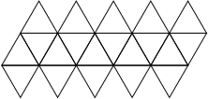

Slide 10
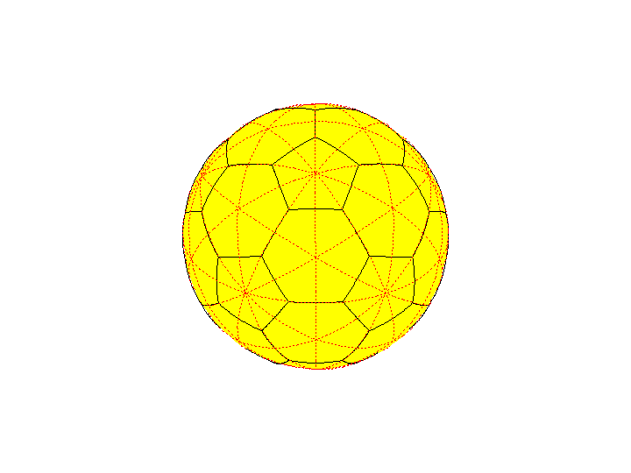
Truncated Icosahedron

Slide 11
Truncated Icosahedron

Slide 12
Historical Context
Triangular grid has several advantages
More compact than square grid
Expected to intensify grid as needed
More subdivision factors than square grid

Slide 13
Historical Context
Scott Overton, Denis White, Jon Kimmerling developed EMAP’s triangular grid + hexagonal tessellation

Slide 14
Historical Context
GRTS design evolved from EMAP work on global tessellations in the early 1990’s
Became clear that basic concept did not have enough flexibility to accommodate the characteristics of environmental resource sampling

Slide 15
Spatial Survey Design
Survey design for Natural Resources
Spatial relationships in population are critical
Elements near one another tend to share
substrate
climate
topography
natural and anthropogenic stressors

Slide 16
Spatial Survey Design
Tobler's First Law of Geography: Things that are close together in space tend to have more similar properties than things that are far apart.
OR
Spatial correlation functions tend to decrease with distance

Slide 17
Sampling Natural Resource Populations
Patterned response (gradients, patches, periodic responses)
Variable inclusion probability
0, 1, and 2 dimensional populations (points, lines, & areas)
Pattern in population occurrence (density )
Unreliable frame material

Slide 18
Spatial Survey Design
Patterned response (gradients, patches, periodic responses)
Variable inclusion probability
Ecological importance, economic importance, environmental stressor levels, scientific interest, and political importance are not uniform over the extent of the resource

Slide 19
Spatial Survey Design
Pattern in population occurrence (density)
Stream or lake density (NE US versus Western US)

Slide 20
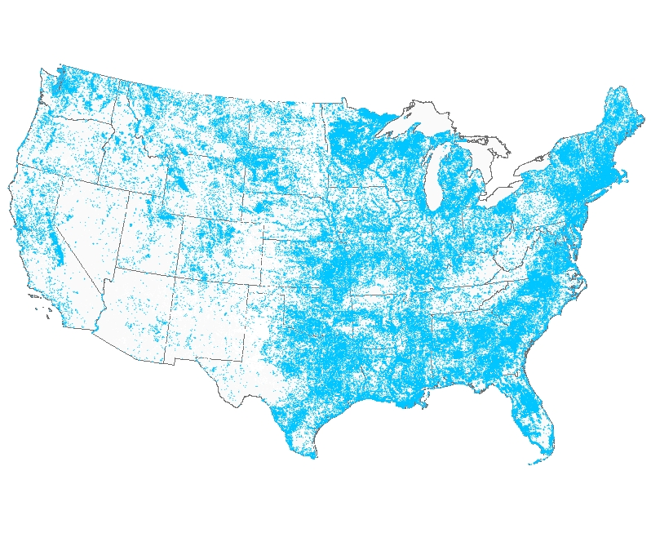
Centroids of lakes/reservoirs in the US

Slide 22
Spatial Survey Design
Unreliable frame material
Access difficulty
Temporal panels for trend assessment
Goals/objectives evolve

Slide 23
Sampling Natural Resource Populations
Natural Resource Populations exist in a spatial matrix
Population elements close to one another tend to be more similar than widely separated elements
Good sampling designs tend to spread out the sample points more or less regularly
Uniform random sampling tends to exhibit uneven spatial patterns

Slide 24
Desirable Properties of Natural Resource Samples
(1) Accommodate varying spatial sample intensity
(2) Spread the sample points evenly and regularly over the domain, subject to (1)
(3) Allow augmentation of the sample after-the-fact, while maintaining (1) & (2)
(4) Accommodate varying population spatial density for finite & linear populations, subject to (1) & (2).

Slide 25
Spatial Survey Design
Standard survey design methodology not well-suited natural resource populations
Overwhelming emphasis on finite populations
Most natural resource populations are naturally conceptualized as continua of points
Can discretize
stream networks by chopping into fixed-length segments or variable length reaches, but difficult to retain spatial relationships
forest or estuary into finite collection of cells, but cells don’t have a natural or ecological interpretation
Inference is then to number, not extent, e.g., number of reaches, of miles of stream

Slide 26
Basic Spatial Survey Designs
Systematic sample
Regular grid for extensive resource
Boundaries?
Regular spacing on linear resource
Confluences?
Finite resource?

Slide 27
Basic Spatial Survey Designs
Systematic sample
Periodic response ⇒ high variance
Less well recognized problem: patch-like response ⇒ high variance
Inflexible sample point density, with respect to both inclusion probability and sample adjustment for frame errors

Slide 28
Basic Spatial Survey Designs
Spatially stratified
Strata can be regular geometric figures (grid cells), arbitrary polygons (ecoregions), political boundaries (state borders), or natural boundaries (watersheds)
Maximum regularity ⇒
few ( 1 or 2) samples per stratum
equal number/length/area in each stratum
Good spatial control, but few samples/strata limit flexibility
Strata formation can be difficult
Notes:
For statistical reasons, sensible to keep strata size & number of samples the same, and number of samples per stratum small

Slide 29
Basic Spatial Survey Designs
Spatial ordering
Serpentine strips
National Agricultural Statistical Service
Graph-theoretical
Saalfeld, 1991
Peano order (Morton order)
Wolter, 1990

Slide 30
RANDOM-TESSELLATION STRATIFIED (RTS) DESIGN
Compromise between systematic & SRS that resolves periodic/patchy response
Cover the population domain with a grid
Randomly located
Regular (square or triangular)
Spacing chosen to give required spatial resolution
Tile the domain with equal-sized regular polygons containing the grid points
Select one sample point at random from each tessellation polygon

Slide 31
RTS DESIGN
Does not resolve systematic sample difficulties with
variable probability
finite & linear populations
pattern in population occurrence (density)
unreliable frame material

Slide 32
Generalized Random-Tessellation Stratified (GRTS) Design
Can achieve variable density by creating a series of nested grids, ordering the RTS points following the nesting, and then sub-sampling.
If we carry the process to the limit, letting the grid cell size → 0, the result is a function f: R² →R. We use this feature to develop a generalization of the RTS design that has all the features we wanted.

Slide 33
GRTS Design
Conceptual structure:
Population indexed by points contained within a region R
Have inclusion probability π(s) defined on R
Select a sample by picking points
Finite: points represent units
π(s) is usual inclusion probability
Linear: points on the lines
π(s) is a density: E(#sample points) /unit length
Extensive: points are in region area
π(s) is a density: E(#sample points)/unit area

Slide 34
GRTS Design Mechanics
Map R into first quadrant of unit square, & add a random offset
Subdivide unit square into “small” grid cells
At least small enough so that total inclusion probability for a cell (expected number of samples in the cell) is less than 1
Total inclusion probability for cell is sum or integral of π(s) over the extent of the cell

Slide 35
Population region image

Slide 36
Population region image + random offset
1.0
0.8
0.6
0.4
0.2
0.0
0.0
0.2
0.4
0.6
0.8
1.0

Slide 37
Population region image + random offset
1.0
0.8
0.6
0.4
0.2
0.0
0.0
0.2
0.4
0.6
0.8
1.0

Slide 38
Population region image + random offset
1.0
0.8
0.6
0.4
0.2
0.0
0.0
0.2
0.4
0.6
0.8
1.0

Slide 39
GRTS Design Mechanics
Order the cells so that some 2-dimensional proximity relationships are preserved, and let the cell size go to zero
Result is a map form unit square to unit interval
Can’t preserve everything, because a 1-1, onto, continuous map from unit square to unit interval is impossible
Can get 1-1,onto, & measurable, which is good enough
GRTS uses a quadrant-recursive function, similar to the space filling curve developed by Guiseppe Peano in 1890.

Slide 40
Assign each cell an address corresponding to the order of subdivision
The address of the shaded quadrant is 0.213
Order the cells following the address order

Slide 41
GRTS Design Theory
We will base the development on functions that map the unit square into the unit interval.
With suitable restriction, we can make f continuous, 1-1, onto, or measureable, but not all at the same time. We choose a restriction that makes f (and f ⁻¹ ) 1-1, onto, measureable, and having a property that preserves some 2-dimensional proximity relationships in the 1-dimensional image

Slide 42
I = (0, 1] I ² = (0, 1] ×(0, 1]
n ≥ 0, j, k = 0, 1, ..., 2^{n} -1
, m = 0, 1, ..., 4^{n} - 1
Definition: f : I ² → I is quadrant-recursive if for all n ≥ 0, and j, k = 0, 1, ...2^{n} - 1, there is some m = 0, 1, ..., 4^{n}-1 such that
Note: A 1-1, quadrant-recursive function is measureable & has a measureable inverse.

Slide 43
QUADRANT-RECURSIVE FUNCTIONS
A basic quadrant-recursive function can be obtained by bit-interweaving:
Let s = (x, y) be a point in I ².
Binary expansion: x = 0.x₁x₂x₃...,
y = 0.y₁y₂y₃..., where each x_{i} and y_{i} is either 0 or 1.

Slide 44
QUADRANT-RECURSIVE FUNCTIONS
Define f₀(s) by alternating successive digits of x and y: f₀(s) = 0.x₁y₁x₂y₂....
Need to be careful: The same number can have different binary expansions:
0.1 = 0.01111111111111111111..........
If we always use the representation with an infinite number of 1's, then f₀ is 1-1.

Slide 45
QUADRANT-RECURSIVE FUNCTIONS
: I → I ² is obtained by “digit-splitting”:
For t = 0.t₁t₂t₃... in I, set
Both f₀ and are 1-1 and onto if we always use the representation with
an infinite number of 1's (Hausdorff, 1957, Peano, 1890).

Slide 46
QUADRANT-RECURSIVE FUNCTIONS
Any quadrant-recursive function can be generated from f₀ by permuting the order in which subquadrants are paired with the intervals . For example, for n = 1,

Slide 47
QUADRANT-RECURSIVE FUNCTIONS
We obtain a different quadrant-recursive function by permuting the subscripts {0, 1, 2, 3} of the image intervals. Thus, under the permutation
τ = {2,1,3,0},
So that

Slide 48
HIERARCHICAL RANDOMIZATION
Express each number in I as a base 4 number, that is, as t = 0.t₁t₂t₃..., where each digit t_{i} is either a 0, 1, 2, or 3. A function h_{p}: I → I is a hierarchical permutation if
where is a possibly distinct permutation of {0,1,2,3} for each unique combination of digits
t₁, t₂, ..., t_{n - 1}.

Slide 49
HIERARCHICAL RANDOMIZATION
Any Q-R function can be represented as a composition
If the permutations that define h_{p}(•) are chosen at random and independently from the set of all possible permutations, we call h_{p}(•) a hierarchical randomization function, and the process of applying h_{p}(•) hierarchical randomization.

Slide 51
GRTS DESIGN Theory
Let
φ(s) be a measure on I ²
π(s) be an inclusion intensity function on I ²
f : I ² → I be the composition of f₀ and a hierarchical randomization function

Slide 52
GRTS DESIGN Theory
Map population domain R into , add random offset to get image R* ⊂ I ²
= extent of population
domain image (number, length, or area)

Slide 53
GRTS DESIGN
= expected sample size
is a (random) distribution function with range (0, M)

Slide 56
quadrant-recursive, hierarchical random map
x=f(s)
s
0 1
x
B(x) = {s|0 ≤ f(s) ≤ x}
F(x) = ∫ π(s)dφ(s)
B(x)
y
M
.
.
s =f⁻¹(x)
.
y
i
F(x)
.
systematic
.
sample
.
y
2
y
1
x
1
x
2
.
.
.
x
.
.
.
x
i
M
x=F⁻¹(y)

Slide 57
GRTS DESIGN
Pick as a systematic sample with random start from (0, M)
Set and
Then is a spatially well-balanced sample from R* with the desired inclusion function.

Slide 58
GRTS DESIGN
Because the u_{i} are ordered, the s_{i} are in “Quadrant-Recursive Order”, that is, successive quarters of the points will all be in the same quadrant (equi-probable case)
Re-order using “Reverse Hierarchical Order”:
Pick the first point in each quarter of the sample
Pick the next 4 points, one from each quarter of the sample and so on

Slide 59
Reverse Hierarchical Order
Illustrate for 2-levels of addressing:
First 16 addresses as base 4-fractions
00 01 02 03 10 11 12 13 20 21 22 23 30 31 32 33

Slide 60
Reverse Hierarchical Order
Illustrate for 2-levels of addressing:
First 16 addresses as base 4-fractions
00 01 02 03 10 11 12 13 20 21 22 23 30 31 32 33
Reversed digits
00 10 20 30 01 11 21 31 02 12 22 32 03 13 23 33

Slide 61
Reverse Hierarchical Order
Illustrate for 2-levels of addressing:
First 16 addresses as base 4-numbers
00 01 02 03 10 11 12 13 20 21 22 23 30 31 32 33
Reversed digits
00 10 20 30 01 11 21 31 02 12 22 32 03 13 23 33
Reversed digits as base 10 numbers
0 4 8 12 1 5 9 13 2 6 10 14 3 7 11 15

Slide 62
Reverse Hierarchical Order
The above algorithm works for sample sizes that are powers of 4, i.e., n = 4^{k}
For other values of sample, need to modify:
Let k be smallest integer such that n ≤ 4^{k}
Form the reverse hierarchical order for the integers 1,,,, 4^{k}
Scale the ordered integers to the range (1, n)
Eliminate any duplicates

Slide 63
Reverse Hierarchical Order
For example, let n = 12
Then k = 2, so that 4^{k} = 16
RHO(16) = (1, 5, 9,13, 2, 6,10,14, 3, 7, 11, 15, 4, 8,12, 16)
RHO(12) = (1, 4, 7,10, 2, 5, 8,11, 3, 6, 9, 12)

Slide 64
100 Point GRTS Sample, QR order

Slide 65
100 Point GRTS Sample, RHO order

Slide 66
SPATIAL PROPERTIES OF REVERSE HIERARCHICAL ORDERED GRTS SAMPLE
The complete sample is nearly regular, capturing much of the potential efficiency of a systematic sample without the potential flaws
Any subsample consisting of a consecutive subsequence is almost as regular as the full sample; in particular, the subsequence
, is a spatially well-balanced sample.
Any consecutive sequence subsample, restricted to the accessible domain, is a spatially well-balanced sample of the accessible domain.

Slide 67
Inclusion probability density surface
Region is (0,1)x(0,0.8)

Slide 69
20 –point GRTS Sample

Slide 70
Four 20-point GRTS Panels

Slide 71
Five 20-point GRTS Panels

Slide 72
Five 20-point GRTS Panels
+ Special Study Area

